Slide 1
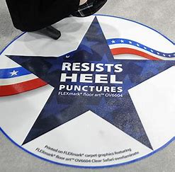
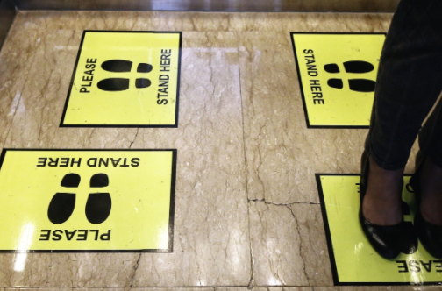
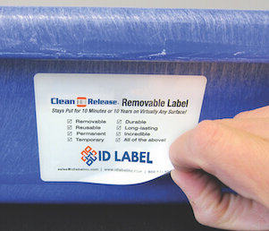
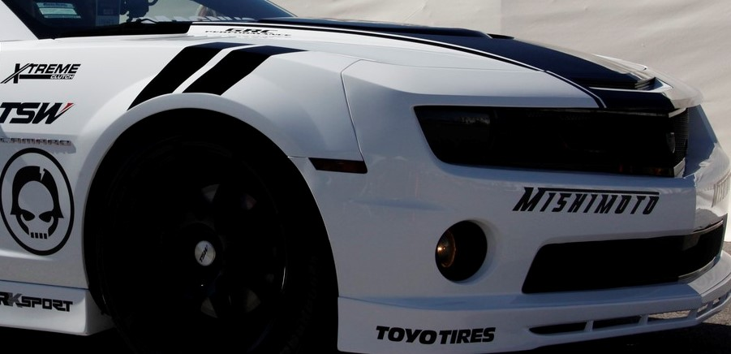

Toyo Ink PSA’s for PVC GRAPHICS
 |  |  | PSTC METHODS | Monomeric PVC | Polymeric PVC | UNITS
BTX-440 | A solvent acrylic permanent PSA designed for general purpose PVC graphics requiring outdoor durability & shrink resistance. Used with the most flexible PVC's, giving excellent anchorage to monomeric & polymeric PVC films. Displays excellent initial repositionability with some long-term removability. For marking films, automotive decals, & clear overlaminates. Its viscosity allows for gap, knife over roll, reverse roll, or comma coating for flawless lamination, wetting and best aesthetics. |  | (15 MIN/180° PEEL/STAINLESS STEEL) | 3.0 | 2.4 | lbs/in
 |  |  | (24 HOUR/180° PEEL/STAINLESS STEEL) | 4.0 | 3.6 | lbs/in
 |  |  | (7 DAYS/180° PEEL/STAINLESS STEEL,AGED) | 4.2 | 3.6 | lbs/in
 |  |  | DRY COAT WEIGHT |  | 25.0 | g/m²
 |  |  | Shear (1"X1"X1KG) |  | >168 | hours
BTX-443 | A solvent acrylic permanent PSA, designed for PVC graphics requiring outdoor durability and shrink resistance & slightly higher Peel Values. It is well suited to the most flexible PVC's, giving excellent anchorage to many monomeric and polymeric PVC facestocks. The viscosity range offers level coating with gap, knife over roll, reverse roll, or comma coating. Excellent wetting & coat ability. |  | (15 MIN/180° PEEL/STAINLESS STEEL) | 3.2 | 2.9 | lbs/in
 |  |  | (24 HOUR/180° PEEL/STAINLESS STEEL) | 5.2 | 5.2 | lbs/in
 |  |  | (7 DAYS/180° PEEL/STAINLESS STEEL, AGED) | 5.3 | 5.6 | lbs/in
 |  |  | DRY COAT WEIGHT |  | 25.0 | g/m²
 |  |  | SHEAR (1"x1"x1 KG) |  | >168 | hours
BTX-441R | A solvent acrylic removable PSA. For temporary durable removable graphics, this PSA anchors well to flexible monomeric and polymeric calendered PVC films. Has excellent initial and long-term adhesion characteristics with minimal build. A great choice for transit graphics, base film PSA for floor signage, durable window graphics, wall murals, temporary hobby decals, or custom automobile graphics and wraps. |  | (15 MIN/180° PEEL/STAINLESS STEEL) | 1.3 | 1.3 | lbs/in
BTX20-012R |  |  | (24 HOUR/180° PEEL/STAINLESS STEEL) | 2.0 | 1.8 | lbs/in
 |  |  | (7 DAYS/180° PEEL/STAINLESS STEEL,AGED) | 2.2 | 2.6 | lbs/in
 |  |  | DRY COAT WEIGHT |  | 25 | g/m²
 |  |  | Shear (1”x1”x1kg) |  | >168 | hours
BTX-291 | A solvent acrylic permanent PSA for general purpose PVC graphics requiring outdoor durability and shrink resistance with the most flexible PVC's giving excellent anchorage to monomeric and polymeric PVC facestocks. Displays excellent initial repositionability & some long-term removability. For marking films, automotive decals, & clear overlaminates. The viscosity allows for gap, knife over roll, reverse roll, or comma coating for flawless lamination, wetting characteristics, and best aesthetics. |  | (15 MIN/180° PEEL/STAINLESS STEEL) | 3.4 | 2.6 | lbs/in
 |  |  | (24 HOUR/180° PEEL/STAINLESS STEEL) | 4.3 | 3.8 | lbs/in
 |  |  | (7 DAYS/180° PEEL/STAINLESS STEEL, AGED) | 3.6 | 3.5 | lbs/in
 |  |  | DRY COAT WEIGHT |  | 25.0 | g/m²
 |  |  | SHEAR (1"x1"x1 KG) |  | >168 | hours
BTX-410 | A highly durable solvent acrylic PSA, appropriate for thick, rigid, or flexible PVC films & foams with high plasticizer content. Exhibits excellent PVC anchorage, high shrink resistance, and good weatherability. Adhesive becomes more aggressive over time to a variety of surfaces, especially at higher coat weight. Can be used for raised marking graphics, as well as traction pads for running boards, swimming pools, ladders, or skateboards. Great choice for adhesion to irregular or curved surfaces. Not recommended where clean removal or clarity is important. |  | (15 MIN/180° PEEL/STAINLESS STEEL) | 3.6 | 2.8 | lbs/in
 |  |  | (24 HOUR/180° PEEL/STAINLESS STEEL) | 4.9 | 4.3 | lbs/in
 |  |  | (7 DAYS/180° PEEL/STAINLESS STEEL, AGED) | 3.5 | 3.4 | lbs/in
 |  |  | DRY COAT WEIGHT |  | 25.0 | g/m²
 |  |  | SHEAR (1"x1"x1 KG) |  | >168 | hours
*We also have pigmented PSA’s – White (BTX-456W), Gray (BTX-455) and can match any color of PSA you might need!
(Also be sure to look at BPS-3156, BPS-6628 & BPS 6574 for EXCELLENT performance on PVC Graphic Applications! Talk with one of our Reps!

