Slide 1
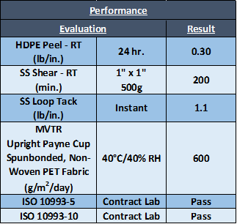
BTX-125
A two-component solvent acrylic PSA. This PSA was designed for low trauma skin applications. Key features are non-silicone, gentle and soft adhesion to the skin, repositionable with minimal pain on removal (Wong-Baker FACES pain rating ≤ 2), wear time from hours to 3 days, ability to be compounded with actives and antimicrobials, non-irritating, non-sensitizing, highly breathable, and low residual monomer. A fantastic choice for advanced wound care, adhesive bandages, wearable sensors, diagnostic monitoring devices, pediatric/geriatric dressings, and reservoir transdermal drug delivery systems.
BTX-110
A two-component solvent acrylic PSA. This PSA was designed for long term wear (≥ 21 days) skin applications. Key features are minimal edge lift and adhesive creep after 21 days, residue-free removal, suitable for challenging skin types such as diaphoretic or hairy skin, highly breathable, ability to be compounded with actives and antimicrobials, non-irritating, non-sensitizing, and low residual monomer. A fantastic choice for advanced wound care, adhesive bandages, wearable sensors, diagnostic monitoring devices, ostomy/colonoscopy pouches, skin closure tapes, and reservoir transdermal drug delivery systems.
BTX-116 & BTX-117
Are two-component solvent acrylic PSAs designed for antimicrobial applications. Key features are proper dispersion of the antimicrobial agent within the acrylic base polymer, 4 log reduction (≥ 99.99%) in gram positive (ex. Streptococcus) and gram negative (ex. E. coli) bacteria for 24 hours, and dried adhesive is clear which allows for visibility of the insertion site when the antimicrobial PSA is used for wound care applications. BTX-116 is a great choice for skin closure tapes, surgical drapes, and first aid bandages, whereas BTX-117 is a great choice for bed rails, tray tables, door handles, floors, and walls.
BTX-116 (Skin Bonding)
BTX-117 (LSE Bonding)
Coating Weight: 50g/m² (as dry)
Dry Up: 120°C for 2 min.
Liner: Commercially available liner.
Base Material: Commercially available 50µm polyester substrate unless noted otherwise.

